Slide 1
Regression project bases on Zomato Delivery data
Project name - Zomato regression model
Dataset - This data is available in Kaggle (https://www.kaggle.com/datasets/saurabhbadole/zomato-delivery-operations-analytics-dataset/data)
Below are the steps to be taken to complete this project.
Project
EDA
Features engineering
Model selection
Conclusion
Deploy
Evaluate the Model

Slide 2
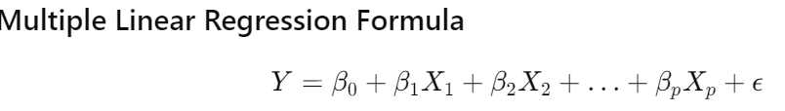
Linear regression model summary:
Initial Data Overview
In the initial stage, we had a total of 18 columns and 30,000 rows.
We cleaned the data and converted some columns to numeric types. Additionally, we applied StandardScaler to minimize the impact of high values by normalizing the data.
Finally, we utilized a ColumnTransformer and a pipeline to streamline the modeling process.
Model Performance
The linear regression model did not perform well with this data, so we are exploring alternative models.
The R-squared score is 49%, with the adjusted R-squared being approximately the same, indicating that we are only explaining 49% of the variance in the dataset.
Performance Metrics
Mean Absolute Error (MAE): 5.30
Mean Squared Error (MSE): 43.12
Root Mean Squared Error (RMSE): 6.57
Notebook link - https://colab.research.google.com/drive/1OoZwUFzXZ-G5Wrfl5zqE7-7D1cdO7-fE#scrollTo=ny5eq1__UViV

Slide 3
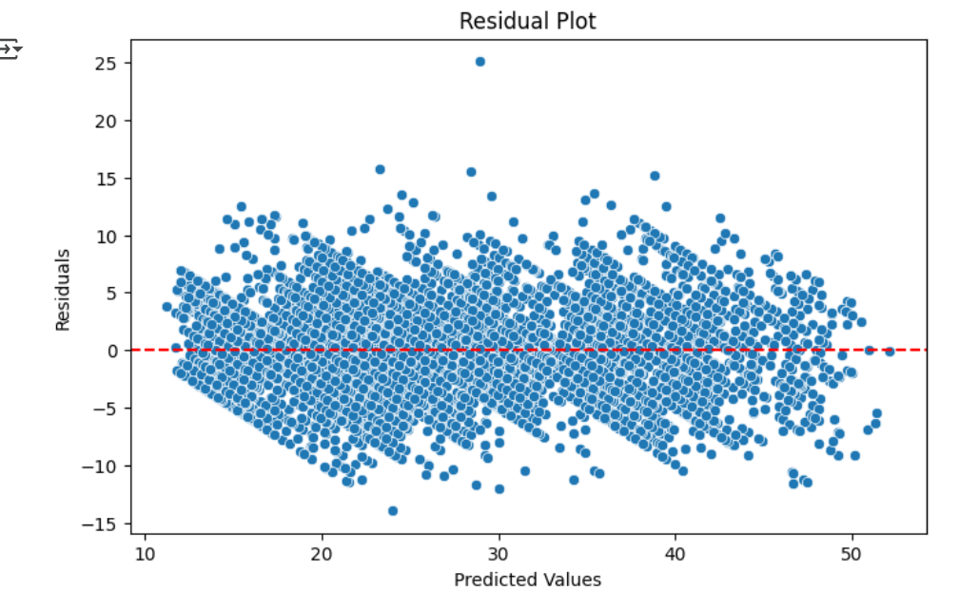
RandomForestRegressor summary:
Model Performance.
The R-squared score is 82%, with the adjusted R-squared being approximately the same, indicating that we are only explaining 82% of the variance in the dataset.
The residual plot shows residuals tightly centered around zero
with no discernible pattern, indicating low bias and
homoscedasticity. This reflects a significant improvement
over the linear model and confirms the
Random Forest Regressor superior fit and predictive accuracy.
Performance Metrics
Mean Absolute Error (MAE): 3.07
Mean Squared Error (MSE): 14.62
Root Mean Squared Error (RMSE): 3.82

Slide 4
Streamlit app
1st view - Dashboard - Analytical view
2nd view - Model predictor

